Slide 1
Securing Cloud Resources
Module 6
Notes:
Before beginning this module, students should have an understanding of the topics and terms presented in the previous modules.

Slide 2
Overview (1 of 2)
In this module, you will learn how to:
Identify threats to cloud security.
Explain cloud-centric security techniques.
Evaluate the relevance of company security policies to shadow IT.
Explain defense-in-depth strategies in the cloud.
Configure allow and deny rules in the cloud.
Determine appropriate security configurations for AWS, Azure, and GCP virtual networks.
Consider needed adjustments when securing hybrid and multi-clouds.
Notes:
This module has several objectives intended to introduce cloud infrastructure concepts and considerations for the Cloud+ certification, as well as common terms that provide a foundation for the certification exam and the remainder of the course.
Instructor Tip
Be sure students understand these objectives so they understand why topics are being covered and their importance in their future careers involving cloud computing technologies.

Slide 3
Overview (2 of 2)
In this module, you will learn how to: (cont’d)
Apply appropriate security measures to compute instances in the cloud.
Evaluate common encryption technologies.
Explain the role of keys in encrypting data.
Distinguish between SSL and TLS.
Evaluate common weaknesses in cloud security.

Slide 4
Module 6 Scenario
Private school migrating VM services to cloud
Team must consider security in the cloud
Firewalls and physical barriers used on-prem
Security tools and measures protect cloud resources
Action list questions
What kinds of threats do cloud users face?
What techniques can keep cloud networks, VM instances, and data secure?
What tools can help in troubleshooting problems with cloud security?
Notes:
The illustrative case is a continuation from the previous modules. It builds on the idea of a private school migrating services and systems to the cloud. In module 6, team members are starting to think about how to keep their materials safe in the cloud. They understand how they keep everything behind a firewall on their school campus. The question raised in the module scenario is: What happens when the school starts moving resources to the cloud? The team will research the security tools and security resources available to protect their cloud resources.

Slide 5
Security Configurations (1 of 13)
Threats to cloud security
Security concerns cause cloud migration hesitation
Cloud consumers face familiar and new threats
New technologies support cloud security
Must understand threats and tools used to protect cloud resources
Common internal and external threats to cloud security exist
Data breaches
Cloud data, no matter where stored, are inherently at risk
Risks due to shared hardware resources
Vulnerabilities due to CSP personnel or third-party providers
Notes:
تردد الهجرة

Slide 6
Security Configurations (2 of 13)
Threats to cloud security (cont’d)
CSP changes or outages
Susceptible to changes and outages experienced by the CSP
SLAs occasionally adapted to keep up with the changes
DoS and DDoS attacks
DoS attack affects availability or performance of services or data
DDoS attack continues until the server is no longer able to respond
Account hijacking
Allows hacker greater leverage for eavesdropping, manipulating data, redirecting customer traffic, reconfiguring cloud resources
Notes:
DoS (denial of service) attack refers to an attack in which a legitimate user is unable to access normal network resources because of an attacker’s intervention. Most often, this type of attack is achieved by flooding a system with so many requests for services that it can’t respond to any of them.
DoS is any kind of attack that affects the availability or performance of services or data.
DDoS (distributed denial of service) attack refers to an attack in which multiple computers simultaneously flood a target with traffic, rendering the target unable to function. Most often, this type of attack is performed by a botnet made up of numerous malware-infected machines without the owners’ knowledge.
Sometimes multiple attackers (or bots) are used in a DDoS (distributed denial of service) attack, such as the flooding of a web server with traffic until the server is no longer able to respond.

Slide 7
Security Configurations (3 of 13)
Threats to cloud security (cont’d)
Poor account management
Increases likelihood of account compromise
Weak passwords; no multifactor authentication; improper storage of account credentials; sloppy handling of credentials
Data loss with no backups
Easy to overlook the need to back up cloud-hosted data
Problems with backup syncing, cloud services crash, accounts being compromised, or accounts deleted for inactivity
Insecure interfaces
Prime targets for hackers attempting to gain entry
Notes:
Poor account management can be caused by weak password rules; lack of multifactor authentication; improper storage of account credentials; inadequate account lifecycle oversight; and sloppy handling of keys, passwords, and certificates, which all put a company and its users at risk.
Insecure interfaces: Whether a UI (user interface) or an API (application programming interface), these points of transition from one system to another can leave security vulnerabilities. Designed for access and interactivity, UIs and APIs are both prime targets for hackers attempting to gain entry.

Slide 8
Security Configurations (4 of 13)
Threats to cloud security (cont’d)
User error
File over-sharing, storing protected information in insecure file storage accounts, poorly designing file names
Insider threats
Use of company resources beyond acceptable use standards
Damages confidentiality, integrity, or availability (CIA) of company data and services
APTs (advanced persistent threats)
Attacks clearing the way for future attacks
Gain foothold in the target’s IT systems and infrastructure
APTs are long-term projects to avoid red flags
Notes:
User error. People make mistakes. Whether from lack of knowledge, carelessness, or willful sloppiness, simple mistakes can create huge problems. Specific to the cloud, file over-sharing, storing protected information in insecure file storage accounts, and poorly designing file names (such as naming a password spreadsheet “passwords”) are all examples of user carelessness that could create some serious legal and economic consequences for their employer.
Insider threats. Beyond user error, malicious users pose an even greater threat. This threat could come from current or former employees, contractors, or business partners who intentionally use company resources beyond acceptable use standards in a way that damages confidentiality, integrity, or availability (CIA) of company data and services.
APTs (advanced persistent threats). APTs (advanced persistent threats) are attacks that clear the way for future attacks, essentially gaining a foothold in the target’s IT systems and infrastructure. APTs are long-term projects where the infiltration blends with normal network traffic so as not to raise red flags. These efforts are more commonly undertaken by large enterprises or government organizations due to the complexity of the attack, the required resources, and the type of data that are targeted.
موطئ قدم

Slide 9
Security Configurations (5 of 13)
Cloud-based approaches to security
Cloud security uses a shared responsibility model
CSP partially responsible for cloud’s security
Customer responsible for the remainder
Cloud highlights need for adaptive technology
Quick response times and creative thinking
Core techniques for maximizing cloud security
DevSecOps
Microsegmentation
Notes:
With new challenges come new innovations. Cloud computing provides a prime example of how security innovations are solving new problems.
Microsegmentation is a method of creating zones in data centers and cloud environments to isolate workloads from one another and secure them.

Slide 10
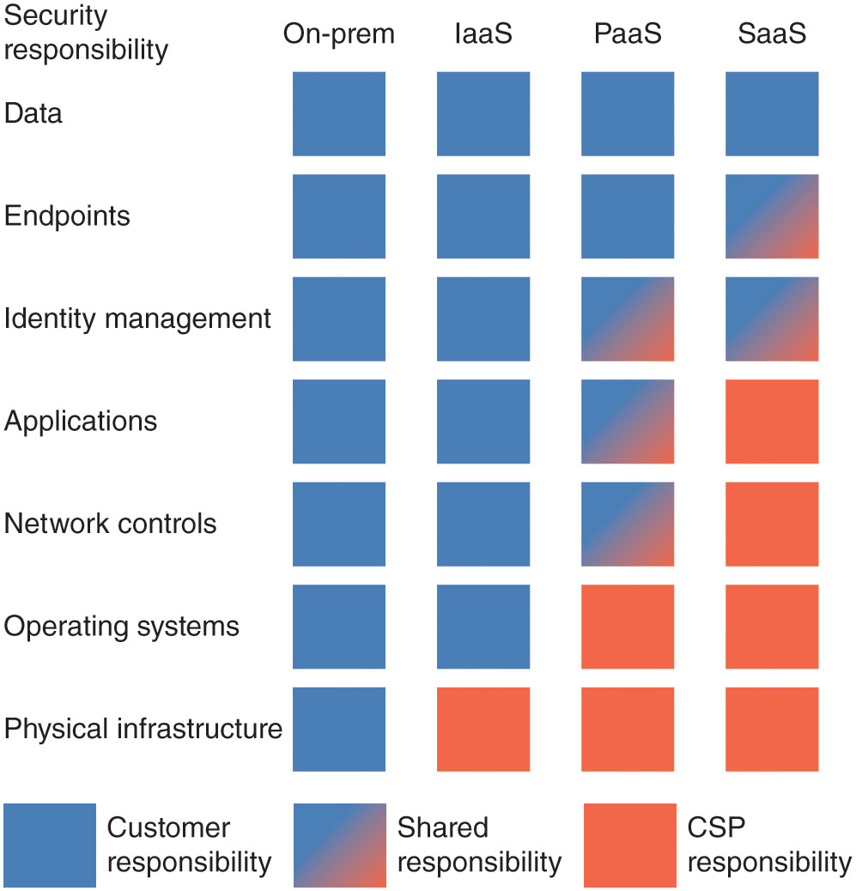
Security Configurations (6 of 13)
Figure 6-1 The customer’s responsibility for security shifts with different cloud deployment structures.
Notes:
Figure 6-1 shows how this shared responsibility breaks down according to the type of cloud deployment.

Slide 11
Security Configurations (7 of 13)
Cloud-based approaches to security (cont’d)
DevSecOps
DevOps culture
Development and operations workflows form a single, unending cycle
Increases feature agility to quickly reflect application’s demands
Invites security team to participate earlier
Provides more flexibly
DevSecOps mantra: “Security is everyone’s responsibility”
Cultural standard applies to cloud computing
Notes:
Traditionally, the application life cycle began with a development team, passed through a security team, and went on to be deployed and maintained by the operations team.

Slide 12
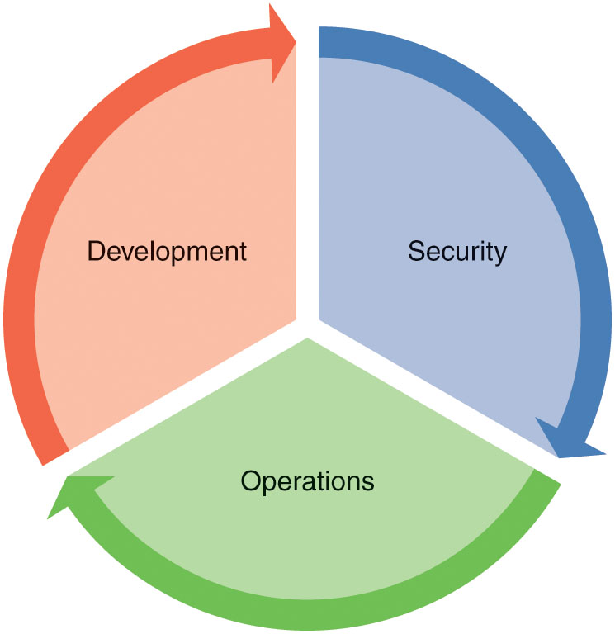
Security Configurations (8 of 13)
Figure 6-2 DevSecOps involves input from all three teams throughout the application’s life cycle.

Slide 13
Security Configurations (9 of 13)
Cloud-based approaches to security (cont’d)
Microsegmentation
Cloud-based security technique providing granular control of traffic and workflows
Zero-trust security model approach
Assumes nothing is trustworthy until proven otherwise
Cloud environment security
Assume communication and user to be a threat until proven otherwise
Must secure communication within and between cloud resources
Traffic is said to travel in a lateral or east–west direction
Notes:
Network segmentation in general is used for many purposes, including increasing both efficiency and security of network communications. Traditional segmentation techniques for on-prem networks include VLANs and firewalls, and cloud-centric segmentation techniques include VPCs and gateways.
In this module, you’ll learn about more cloud-centric security tools, such as security groups and network ACLs (access control lists). To put these tools in context, you’ll need to learn first about microsegmentation.
Microsegmentation refers to a security technique that allows for granular control of traffic and workflows within a cloud-based network.
Zero-trust security model refers to a security approach that assumes nothing in the network is trustworthy until proven otherwise.
يقال إن حركة المرور تسير في اتجاه جانبي أو شرق - غرب

Slide 14
Security Configurations (10 of 13)
Cloud-based approaches to security (cont’d)
Microsegmentation (cont’d)
Helps monitor and restrict east–west activity
Applies security measures to workloads, VMs, network connections
Security policies travel with the resource
Microsegmentation tools
Often application-aware
Allow fine-tuned information flow
Control and monitor communications components residing in different locations within an organization’s cloud
Notes:
Microsegmentation tools are often application-aware.
Allows for fine-tuned control of exactly what kinds of information can flow between two systems, applications, or networks.
Applications themselves often comprise multiple components residing in different locations within an organization’s cloud. For example, a web app running on a web server might rely on a database hosted in an entirely different location. The communications between these components can be controlled and monitored by microsegmentation tools.

Slide 15
Security Configurations (11 of 13)
Company security policies
Easy to miss internal threats when focusing on cloud threats
High accessibility of cloud services allows shadow IT services
IT services not submitted to formal approval processes
Benefit of shadow IT
Employees get needed tools quickly and easily
Increases efficiency and productivity
Downside of unmonitored shadow IT resources
Security gaps and blind spots
Organization-wide inefficiency if resources not managed on a large scale
Notes:
Shadow IT refers to IT resources or systems in an organization that were not submitted to formal approval processes and likely exist outside the knowledge or oversight of the IT department.
الجانب السلبي لموارد الظل غير الخاضعة للرقابة
الثغرات الأمنية والنقاط العمياء
عدم الكفاءة على مستوى المنظمة إذا لم تتم إدارة الموارد على نطاق واسع

Slide 16
Security Configurations (12 of 13)
Company security policies (cont’d)
Common shadow IT components
Cloud-hosted applications, cloud services (PaaS and IaaS), installed software, hardware (Wi-Fi hotspots, servers, tablets, mobile devices)
Shadow IT sprawl management
Establish clear company security policies
Educate users about the need for and scope of the policies
Shadow IT biggest concern
Protection of regulated data (customer personal information)
Company policy must protect regulated data from shadow IT solutions
Notes:
Company policy should emphasize that no regulated data can be stored or processed through shadow IT solutions.
At the same time, consider that guidelines for how best to use shadow IT products might be more beneficial both for IT and for other employees. These guidelines can provide direction toward products that are known to be more reliable, such as Office 365, rather than blocking well-known apps only for employees to resort to less secure options. Opening those lines of communication so that employees feel supported in finding the solutions they need will enable IT to provide both support and protection more effectively.

Slide 17
Security Configurations (13 of 13)
Layered security
Cloud resources layers
Platform, network, instances, applications, and data
Apply defense-in-depth (DiD) strategies at each layer
Patchwork system
Uses pieces of one security tool and pieces of another
Leaves gaps in coverage and it is difficult to monitor feedback
Unified, end-to-end cloud security system
Rely on CSP’s built-in security tools
Note that challenges can arise when blending multiple CSPs
Notes:
There are various perspectives on how to best cover each layer.
Many organizations end up with a patchwork system that uses pieces of one security tool and pieces of another. This is dangerous in that it can leave gaps in coverage. It’s also difficult to monitor feedback from multiple security systems.
A better approach is to use a unified, end-to-end cloud security system. This often means relying on a CSP’s built-in security tools, which helps eliminate compatibility issues, increases visibility into your cloud infrastructure, collects monitoring activities in a central location, and scales more efficiently as business needs expand. New challenges arise when blending multiple CSPs, but even in these circumstances, CSPs are catching on and providing security solutions that bridge the gap between various cloud platforms.

Slide 18
Virtual Network Security (1 of 27)
Allow and deny rules
Layers of VPC (virtual private cloud) security exist
AWS has private subnet logically isolated from the Internet with no direct access to an Internet gateway
Can control instance’s public IP address and what routes allow traffic between subnets or other gateways
VPNs can control traffic reaching a subnet and encrypt traffic as it crosses a WAN connection
Load balancing filters traffic allowed to reach a subnet from the open Internet

Slide 19
Virtual Network Security (2 of 27)
Allow and deny rules (cont’d)
Cloud platform level built-in security
Provides protection to cloud resources
Example of cloud platform level built-in security
Azure includes built-in DDoS protection
Cloud consumer does not need to configure
Azure resources reside in environment covered by these measures
Cloud consumer can apply, configure, manage security
Not a true perimeter
Can still manage traffic to and from a virtual network
Includes allow and deny rules as a common component

Slide 20
Virtual Network Security (3 of 27)
Allow and deny rules (cont’d)
How these rules work on a basic level
Message crosses a firewall (physical or virtual)
Firewall checks its rules
Determines if message is allowed to pass
Firewall rules usually applied in order of priority
Highest-priority rule is checked first
If message allowed or denied, no further rules checked
If rule does not apply to the message, the firewall moves to next rule

Slide 21
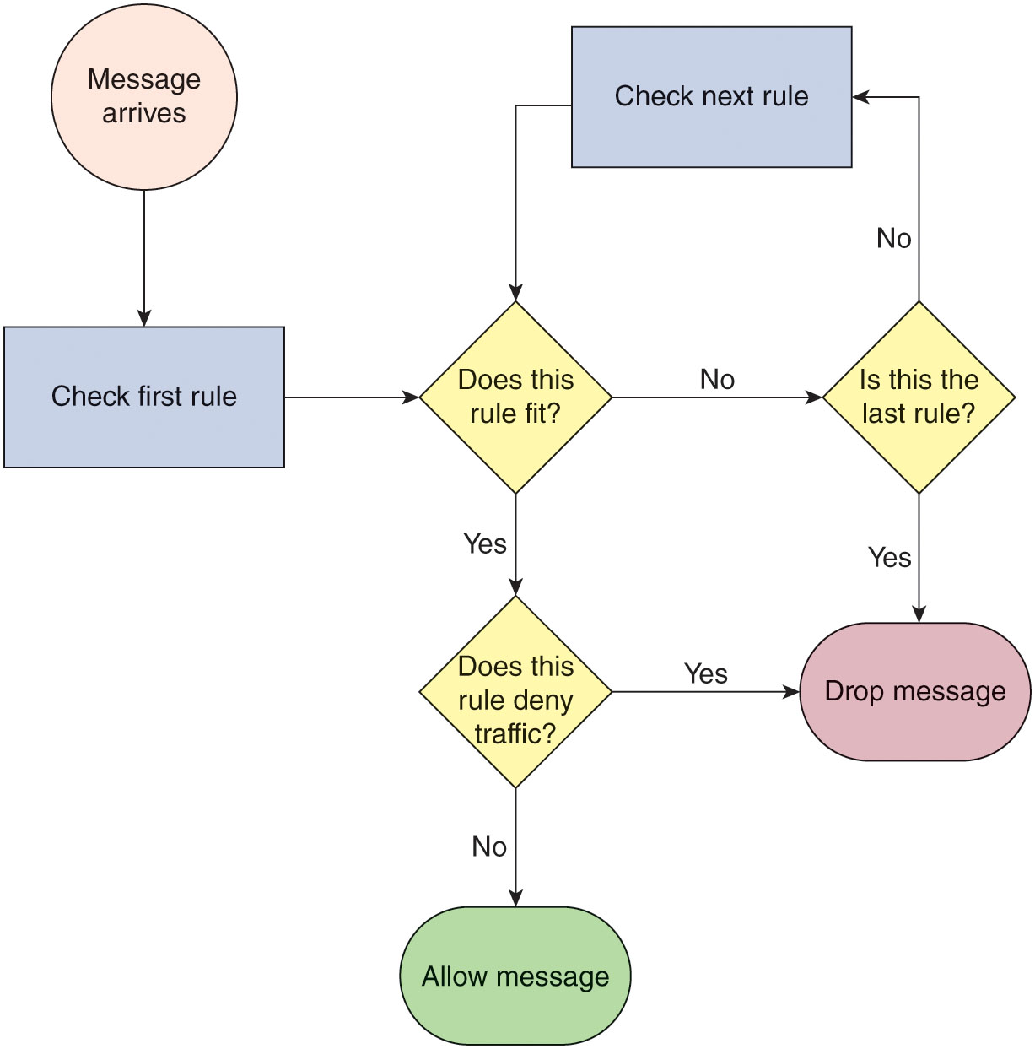
Virtual Network Security (4 of 27)
Figure 6-3 Firewall rules are checked in order of priority to determine whether a message is allowed to pass.
Notes:
Figure 6-3 shows a diagram of how the firewall rule checking process plays out.

Slide 22
Virtual Network Security (5 of 27)
AWS VPCs and subnets
NAC (network access control)
Balances network access with network security
Employs network policies determining level and type of access granted
NACL (Network Access Control List)
Virtual, network firewall
Limits or allows traffic into and out of a VPC’s subnets
Initially every VPC subnet associated with the default NACL
By default NACL initially allows all traffic
Possible to change default rules or create custom NACLs
Can use one NACL for multiple subnets
Each subnet must have exactly one NACL
Notes:
Instructor Note
As an example of using NAC, setting up a NAT gateway to a private subnet in AWS allows that subnet’s VMs to access the Internet without exposing them directly to Internet traffic. In addition to the segmentation provided by public and private subnets, AWS offers more techniques for securing VPCs and the resources contained within them, as described next.

Slide 23
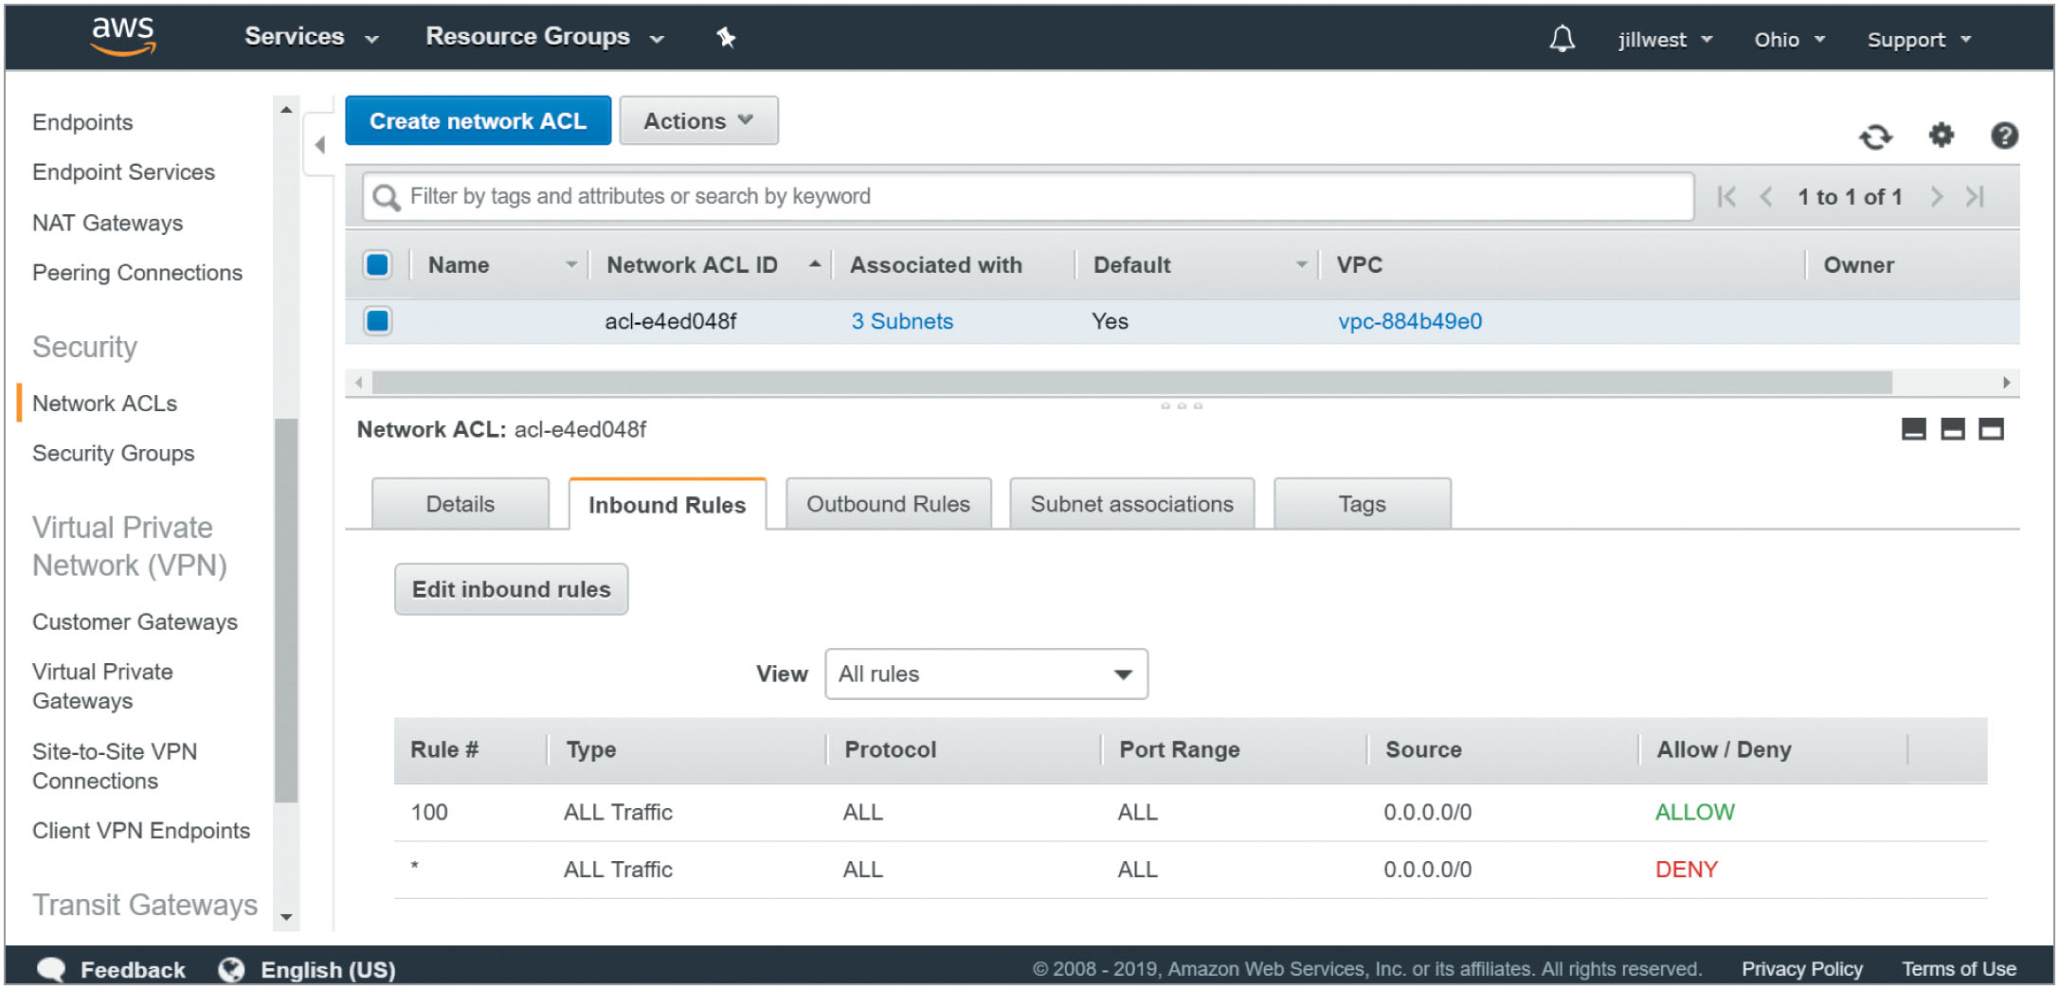
Virtual Network Security (6 of 27)
Figure 6-4 The default NACL rule of highest priority allows all traffic to enter the VPC.
Notes:
Figure 6-4 shows the default NACL inbound rules near the bottom of the screen.

Slide 24
Virtual Network Security (7 of 27)
AWS VPCs and subnets (cont’d)
NACL (cont’d)
Specific NACL characteristics
NACL rules can either allow or deny traffic
NACL rules are numbered for priority - start with lowest number
Applicable rule is enacted immediately - no other rules viewed
Rules are stateless - inbound and outbound traffic evaluated by separate rules

Slide 25
Virtual Network Security (8 of 27)
AWS VPCs and subnets (cont’d)
Security groups
Serves as a virtual firewall at the host level
Rules controlling whether traffic can cross an instance’s network interface
Function on the instances within a subnet, not on the subnet itself
Can associate up to five security groups per instance
Instances within a subnet do not have to use the same security groups

Slide 26
Virtual Network Security (9 of 27)
AWS VPCs and subnets (cont’d)
Security groups (cont’d)
AWS best practices
Primary firewall kind of protection for instances should be managed through the security group feature
Rather than relying primarily on the NACL
Additional key differences between NACLs and security groups
Security group rules only allow traffic
Security group rules are stateful
All security group rules evaluated with the most specific rule to the type of traffic applied
Notes:
AWS best practices state that the primary firewall kind of protection for instances should be managed through the security group feature rather than relying primarily on the NACL.
Some other key differences between NACLs and security groups are as follows:
Security group rules only allow traffic—you can’t create deny rules for security groups.
Security group rules are stateful, meaning that return traffic for an existing connection is allowed regardless of any other security group rules.
All security group rules are evaluated when determining whether to allow traffic to enter an instance’s interface, and the most specific rule to the type of traffic is applied.

Slide 27
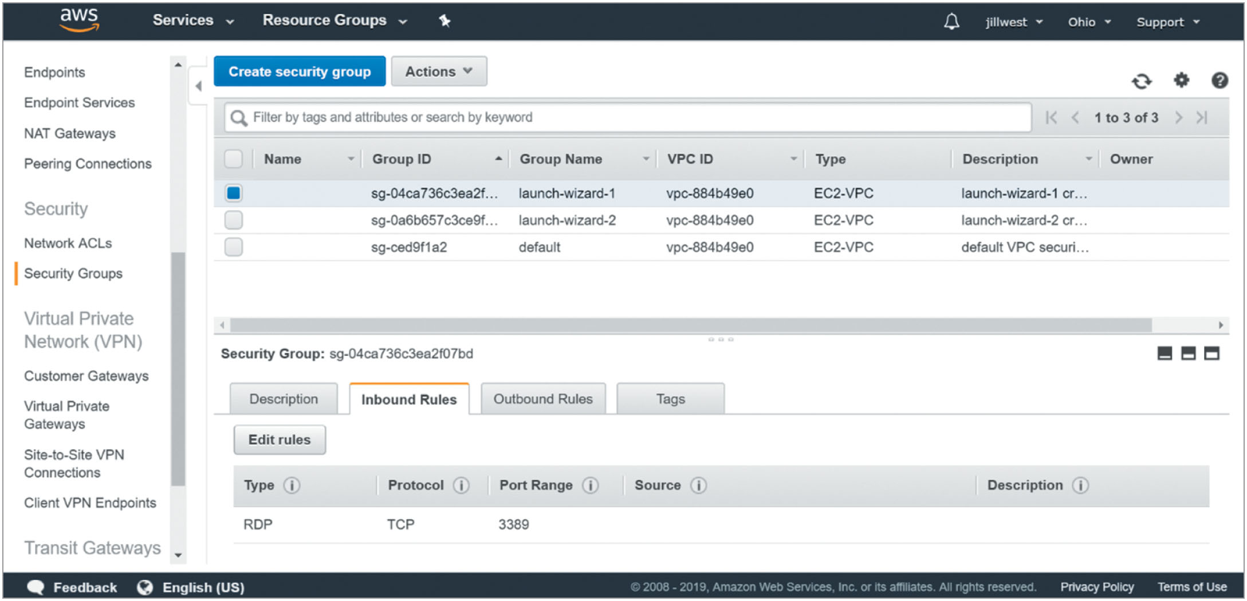
Virtual Network Security (10 of 27)
Figure 6-5 This security group’s inbound rules only allow RDP traffic—all other incoming traffic is denied.
Notes:
Figure 6-5 shows a security group rule allowing RDP traffic.

Slide 28
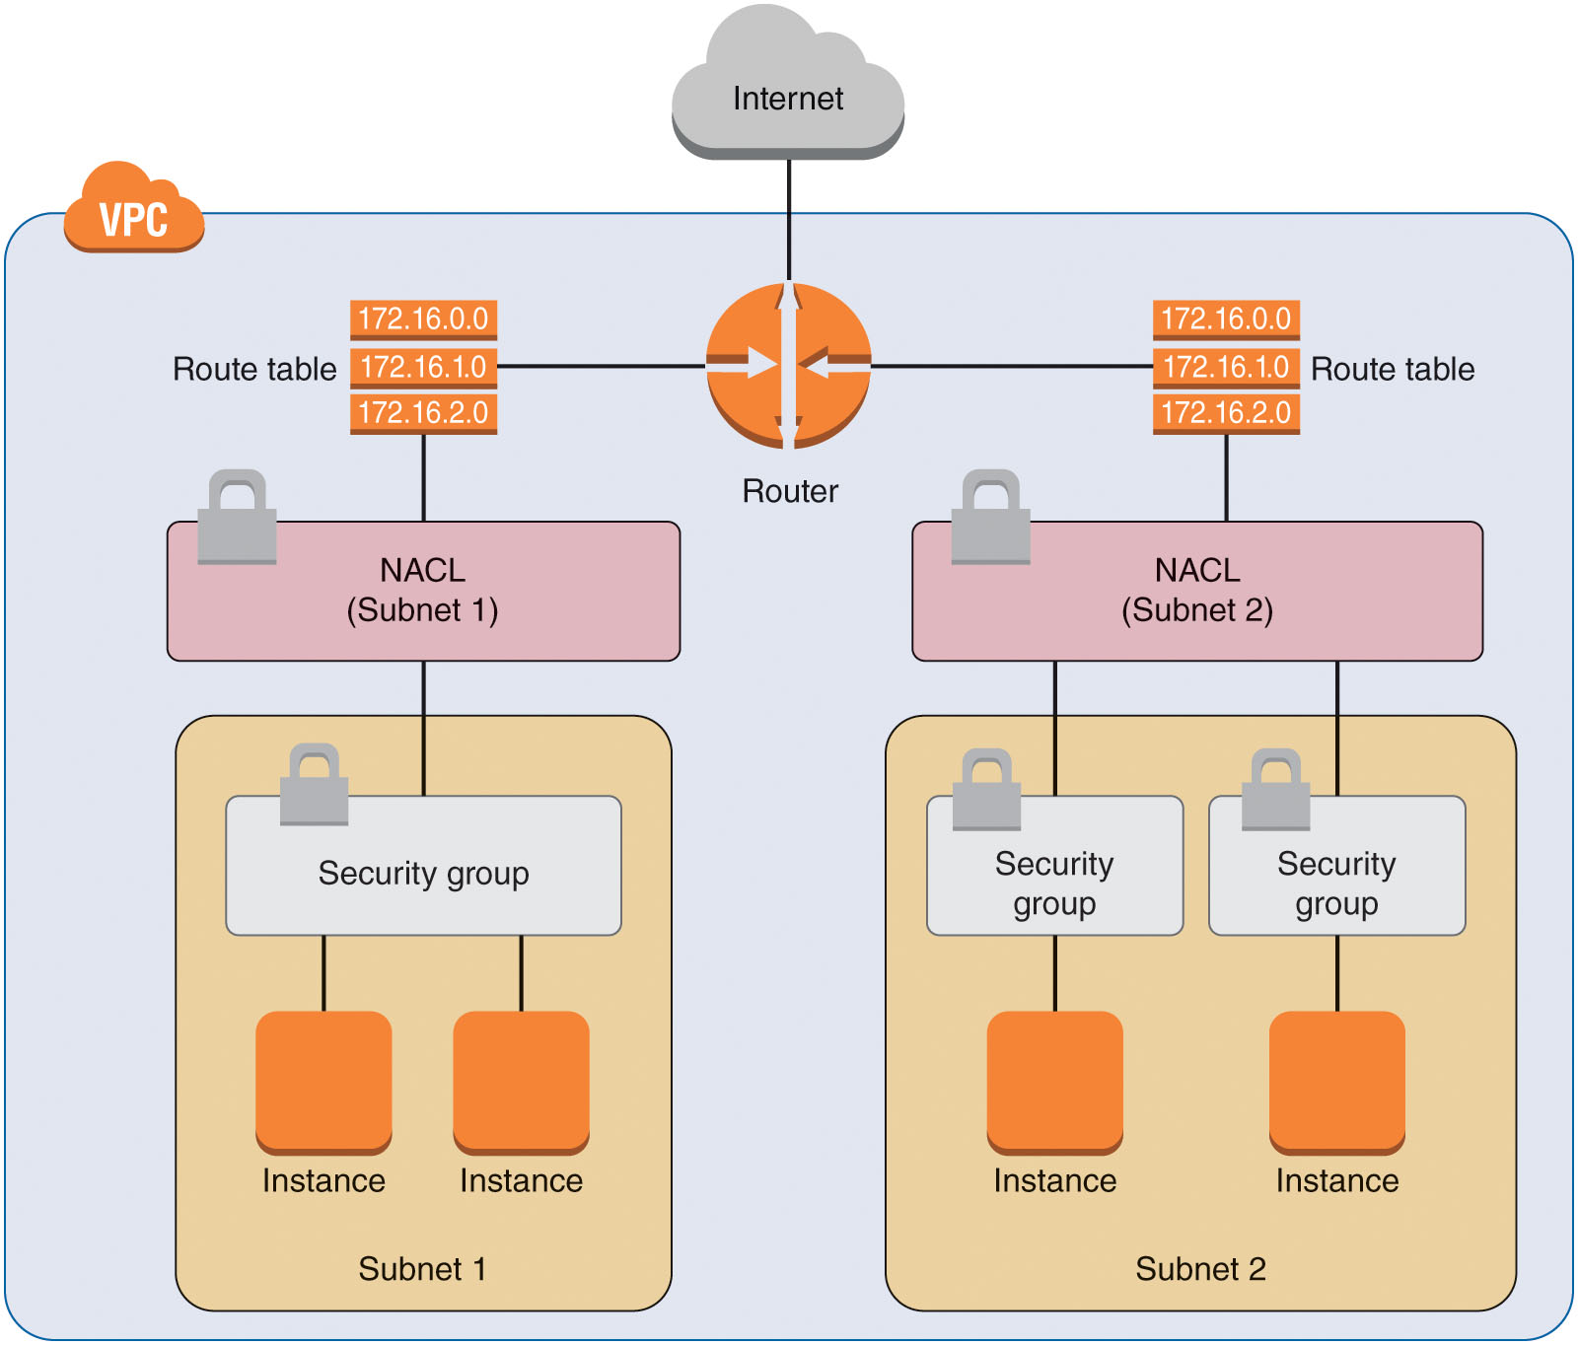
Virtual Network Security (11 of 27)
Figure 6-6 NACLs apply to subnets while security groups apply to instances.
Notes:
The diagram in Figure 6-6 shows the relationship of NACLs, VPCs, security groups, and instances in AWS.

Slide 29
Virtual Network Security (12 of 27)
AWS VPCs and subnets (cont’d)
Flow logs
VPC flow logs monitor traffic crossing an individual network interface
Similar to Wireshark (wireshark.org) on a physical network interface
Creates a flow log for a VPC or subnet
All interfaces within VPC or subnet monitored
Log data directed to CloudWatch Logs service or Amazon S3 storage bucket
Activity accrues charges to your account
Flow logs collect traffic data for a period of time before publishing new record, delaying the availability of information for review
Notes:
Fields within flow log records include information such as source and destination IP addresses (IPv4 or IPv6), source and destination ports, number of packets and bytes, start and end times, and whether the traffic was accepted or rejected.
Because flow logs collect traffic data for a period of time (such as 15 minutes) before publishing each new record, there is a delay from when the traffic occurs until that information is available for review.

Slide 30
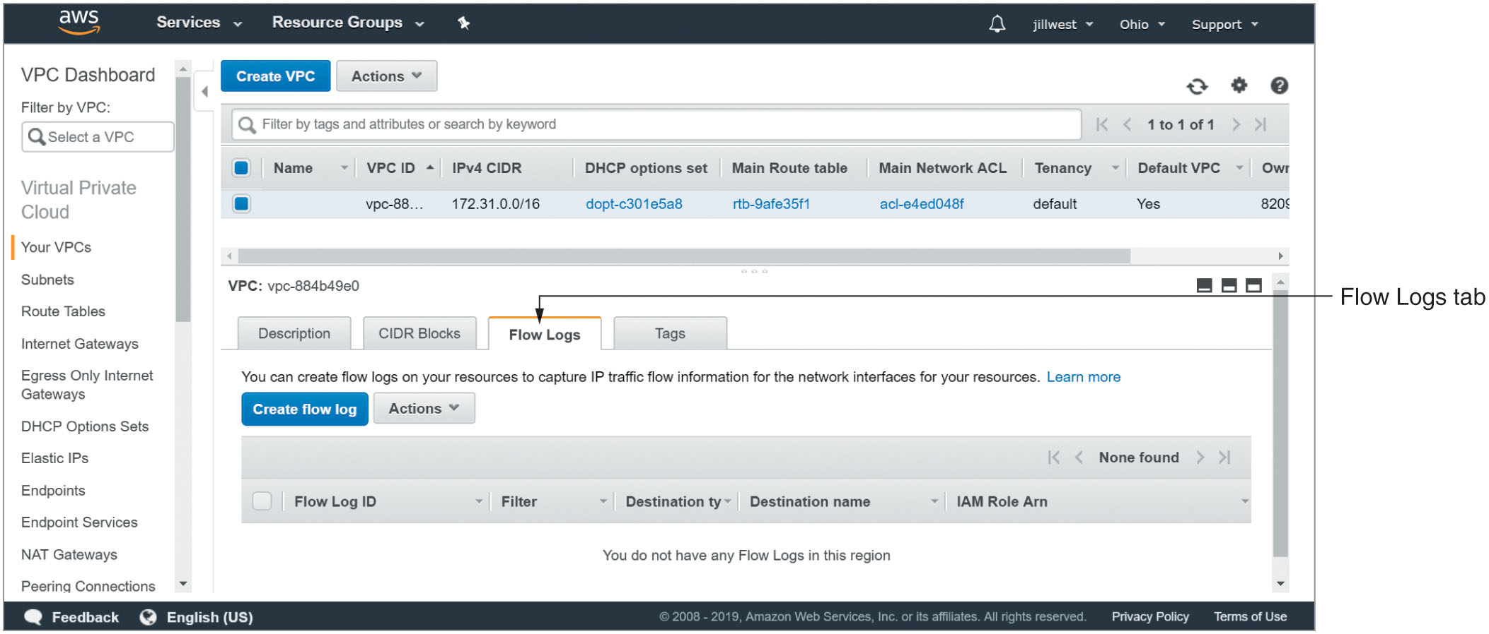
Virtual Network Security (13 of 27)
Figure 6-7 Find a VPC’s flow logs.
Notes:
Figure 6-7 shows where to find flow logs in a VPC’s configuration information.

Slide 31
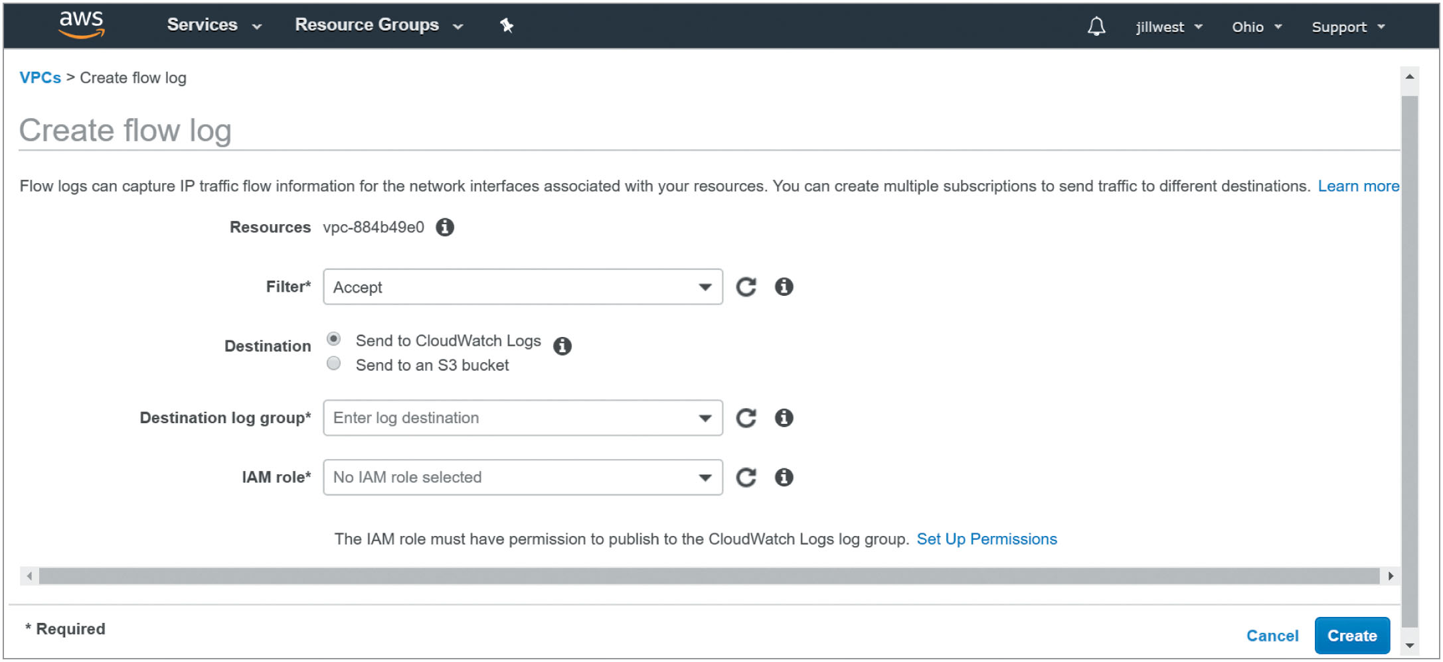
Virtual Network Security (14 of 27)
Figure 6-8 Choose an Accept, Reject, or All filter, then choose a log destination and IAM role to create a flow log.
Notes:
Figure 6-8 shows how to create a flow log.

Slide 32
Virtual Network Security (15 of 27)
Azure virtual networks
Microsoft recommends a perimeter network in an Azure cloud
Perimeter network
Restricts and manages Internet traffic to protected resources
Subnet within a VNet that functions as a DMZ (demilitarized zone)
DMZ (demilitarized zone)
Area on the perimeter of a network
Less protected than the internal network
Provides internal resources with a transitive connection to external resources
Notes:
DMZ (demilitarized zone) refers to an area on the perimeter of a network that is less protected than the internal network and provides internal resources with a transitive connection to external resources.

Slide 33
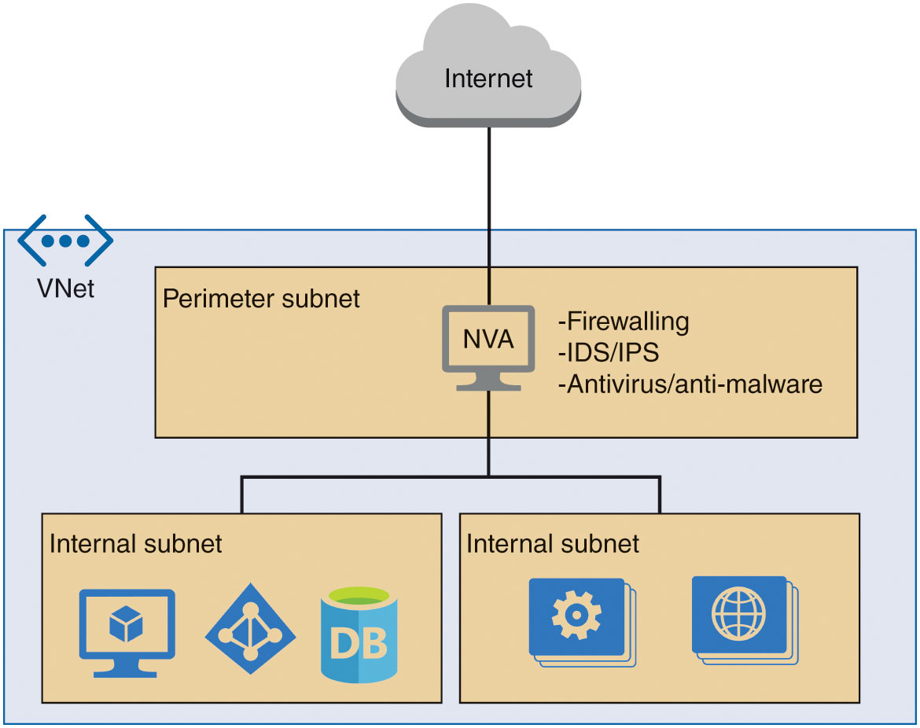
Virtual Network Security (16 of 27)
Figure 6-9 The perimeter network provides a level of isolation for internal subnets from the Internet.
Notes:
Figure 6-9 shows how a perimeter network is implemented conceptually.

Slide 34
Virtual Network Security (17 of 27)
Azure virtual networks (cont’d)
NVA (network virtual appliance)
VM running in the perimeter network controlling traffic between that network (DMZ) and other subnets
Third-party NVAs provide additional features including firewalling, IDS/IPS, antivirus products
NVA can manage ingress traffic, egress traffic, or both
NVA operates at OSI Layer 4 (Transport layer) or OSI Layer 7 (Application layer)
NVAs can manage traffic to and from the on-prem network
Provide high availability (HA) by deploying multiple NVAs
Notes:
An NVA is similar in concept to the IG (Internet gateway) in an AWS public subnet except that it connects the internal subnets with the DMZ and not directly to the Internet.
دخول حركة المرور
Third-party NVAs from the Azure Marketplace can provide additional security features and traffic management capabilities, such as the following:
Firewalling: Firewalls filter what traffic is allowed to enter the network based on defined rules.
IDS/IPS: An IDS (intrusion detection system) identifies activity that appears suspicious and reports on that activity. An IPS (intrusion prevention system) acts to mitigate malicious activity.
Antivirus: Antivirus and anti-malware products identify, block, and remove malware infections.

Slide 35
Virtual Network Security (18 of 27)
Azure virtual networks (cont’d)
NSG (network security group)
Azure NSG provides firewall-style protection at the subnet level
NSG can be applied to a single interface on a VM instance
Microsoft recommends using an NSG for an entire subnet
Azure creates six default rules for every NSG
Three for inbound traffic (see Table 6-1)
Three for outbound traffic (see Table 6-2)
Rules cannot be removed or altered
Can override rules by creating higher-priority rules
Lower numbers represent higher priorities
Notes:
Instructor Tip
As an example of NSG rules, review Tables 6-1 and 6-2. The first rule in Table 6-1 has a priority of 65,000 and allows all traffic within the VNet. The last rule in Table 6-1 has a priority of 65,500 and denies all traffic, regardless of where it comes from or where it’s going. But this rule has the lowest priority rating (65,500), which is a much lower priority than the first rule listed (65,000). If traffic matches the AllowVNetInBound rule, meaning it comes from a resource within the VNet and is sent to a resource also inside the VNet, the traffic is allowed, even though a lower-priority rule would deny that traffic.

Slide 36
Virtual Network Security (19 of 27)
Azure virtual networks (cont’d)
NSG (network security group) (cont’d)
Priority ratings for custom rules can range from 100 to 4096
NSG rules are stateful
Once a message is allowed to cross the NSG, later messages in that conversation continue to be allowed
ASG (application security group)
Subgrouping of an NSG allowing for microsegmentation of security policies according to application and workload type within the VNet
Can associate one or more ASGs to each network interface
Notes:
Instructor Note:
You could create a rule with a priority rating of 4000 that denies HTTP traffic between VNet resources, and this rule would trump the lower-priority rule, AllowVNetInBound, whose priority rating is 65,000, which would have allowed that traffic.
Instructor Note:
NSG rules are stateful, meaning that once a message is allowed to cross the NSG, later messages in that conversation continue to be allowed. For example, imagine an incoming HTTP (Hypertext Transfer Protocol) message on port 80 requesting web page information is allowed through to a subnet that holds a web server. The web server can then reply to the request even if outgoing rules don’t specify that traffic is allowed on port 80. The same is true in reverse. If a subnet’s NSG allows an instance inside the subnet to send traffic on port 80 to external websites, inbound responses from those websites are allowed even if port 80 is not explicitly allowed by an inbound NSG rule.
Instructor Tip
As an example of using an ASG, the student might configure one group of VM interfaces to allow access to an application’s database, while another ASG in the VNet might not have this access. ASGs can also be identified as a source or destination for NSG rules.

Slide 37
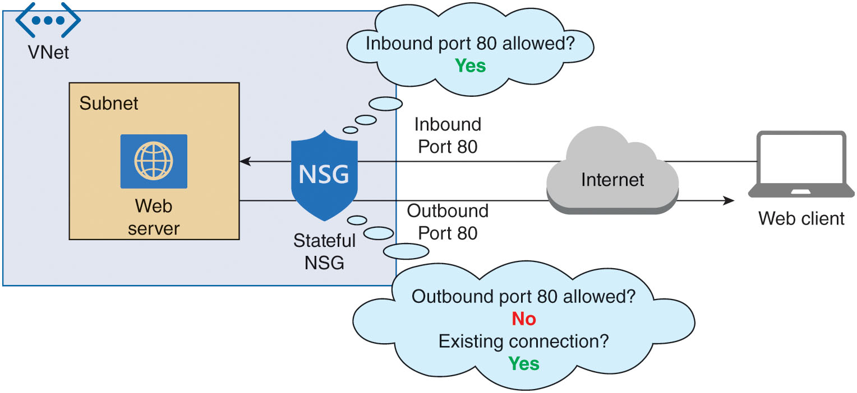
Virtual Network Security (20 of 27)
Figure 6-10 Return traffic on an existing connection is allowed by the NSG.
Notes:
Figure 6-10 shows how NSG stateful connections work to support a connection between a web client and a web server.

Slide 38
Virtual Network Security (21 of 27)
GCP VPCs
GCP resource segmentation first achieved at the project level
Place logically related resources in the same project
Host resources with no need to communicate in different projects within the organization
Can managing traffic into and out of a VPC with other tools
Virtual firewall
Firewall rules set at the network level manage IPv4 traffic into and out of the VPC
Rules work within the VPC between the VPC’s own resources
Rules can be set to target specific protocols, ports, sources, or destinations

Slide 39
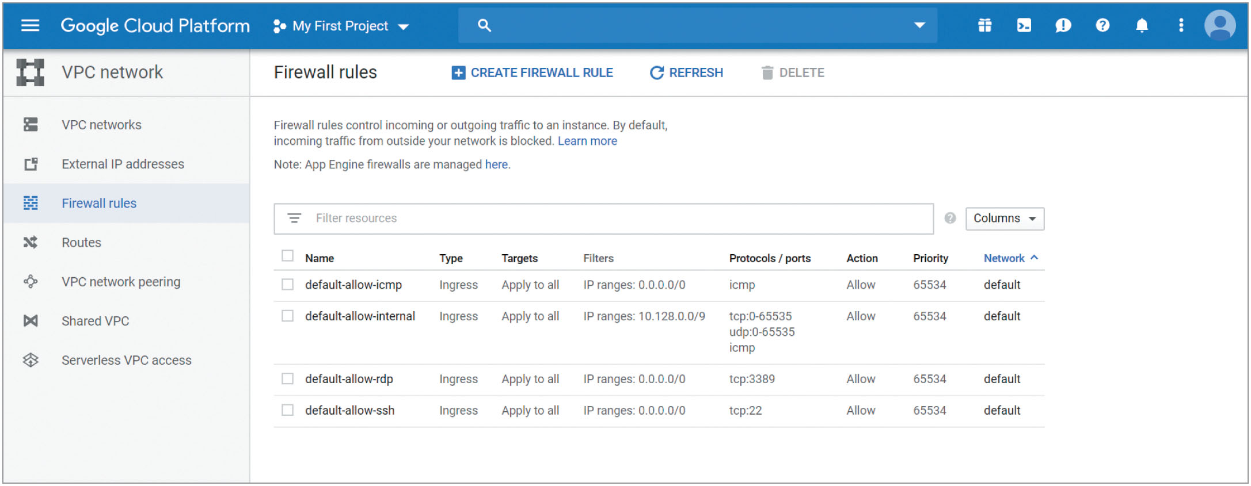
Virtual Network Security (22 of 27)
Figure 6-11 Firewall rules can apply to one, some, or all instances within a VPC.
Notes:
Firewall rules, as shown in Figure 6-11, are set at the network level to manage IPv4 traffic into and out of the VPC.

Slide 40
Virtual Network Security (23 of 27)
GCP VPCs (cont’d)
Virtual firewall (cont’d)
Some traffic like tunneling protocol GRE (generic routing encapsulation) always blocked
Some traffic like DHCP and DNS traffic always allowed
Can set firewall rules to allow or deny specific types of traffic
Firewall rules applied first according to priority and then by how specifically the rule matches the traffic
Firewall rules are stateful
Need activity every 10 minutes to keep connection open
Can enable firewall rules logging
Notes:
Firewall rules are also stateful, meaning that traffic allowed in one direction automatically allows traffic in the other direction for an active connection.
As long as at least one message goes in either direction within 10 minutes, the connection is kept active.
You can enable firewall rules logging in order to monitor the effects of specific rules on your VPC traffic.

Slide 41
Virtual Network Security (24 of 27)
GCP VPCs (cont’d)
VPC flow logs
VPC flow logs service enabled at the subnet level
Flow logs track TCP and UDP traffic for all instances in the subnet
Log records contains two field types: base fields and metadata fields
Metadata fields can be excluded from flow log records to save space
Log record captures take up a great deal of storage space
Records stored in a GCP storage service such as Stackdriver Logging
Storage incurs charges
Use logs for troubleshooting connectivity issues, monitoring network performance, network forensics
Notes:
Each VPC flow log record contains two types of fields:
Base fields are common to all log records, such as connection type, start time, and bytes sent.
Metadata fields are specific to the type of log record and, for VPC flow logs, contain information such as source and destination instance and source and destination location. To save storage space, metadata fields can be excluded from flow log records.

Slide 42
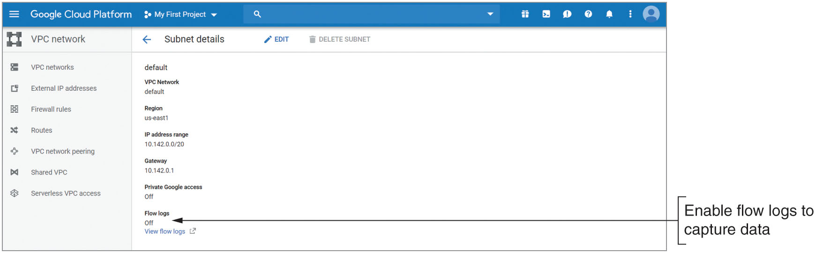
Virtual Network Security (25 of 27)
Figure 6-12 Enable flow logs in the subnet settings.
Notes:
As shown in Figure 6-12, the VPC flow logs service is enabled at the subnet level.

Slide 43
Virtual Network Security (26 of 27)
Securing hybrid and multi-clouds
Must blend different security tools into a unified system for both simplicity and effectiveness
Cloud security techniques must auto-scale
On-prem security tools must have deep access within the network perimeter
Same best practices apply for hybrid and multi-clouds
Encrypting data
Monitoring activity on the network
Using segmentation and microsegmentation to isolate certain resources

Slide 44
Virtual Network Security (27 of 27)
Securing hybrid and multi-clouds (cont’d)
CASB (cloud access security broker) tool
Detects applications and other resources running within a domain
Can detect resources the IT staff may not know about
Can monitor resources according to policies set by the organization
Increases transparency on the network both on-prem and in the cloud
Provides a central dashboard for managing security across the cloud and on-prem environments
Examples
Bitglass’s Zero-day CASB
Masergy’s Managed CASB
Notes:
CASB (cloud access security broker) refers to a security appliance, either physical or virtual and hosted on-prem or in the cloud, that is designed to detect applications and other resources running within a domain and monitor those resources according to policies set by the organization.

Slide 45
Compute Security (1 of 3)
Securing VM instances
Standard methods apply to VM instances running in the cloud
Cloud security options are dependent on cloud platform tools
Possible techniques
Plan subnet placement
Carefully choose the subnet for each instance
Ensure subnet only has necessary access to the outside world
Disable unneeded ports and services
Only enable ports and services that are needed
Disable RDP (port 3389) and SSH (port 22) traffic from any Internet address
Notes:
VM instances require patches, updates, and anti-malware measures to protect them from external threats.
Plan subnet placement
Carefully choose the subnet for each instance so that it has only the necessary access to the outside world.
Example: Place only the AWS EC2 instances that need direct access to the Internet in a public subnet.
Disable unneeded ports and services
Just like with a physical machine, only enable ports and services that are needed.
Example: Don’t allow RDP (port 3389) or SSH (port 22) traffic from any Internet address (using the wildcard 0.0.0.0/0) to VMs. To remote in to those VMs, use VPN or direct connect options instead, or at the very least, specify the public IP address for the computer you’re working from.
RDP (Remote Desktop Protocol)

Slide 46
Compute Security (2 of 3)
Securing VM instances (cont’d)
Possible techniques (cont’d)
Enforce account management policies
Deactivate any default user accounts
Require other, best-practice account management policies
Install antivirus/anti-malware software and keep it updated
Windows Server can use pre-installed Windows Defender software
Other OSs can install sufficient antivirus/anti-malware software
Might be accomplished through the VM’s OSs
Might be available as a service from the cloud platform
Notes:
Enforce account management policies
Linux distros are configured with default user accounts, which are used to remote in to your VMs.
To further protect these virtual systems, deactivate any default user accounts and require other, best-practice account management policies such as password complexity and least privilege access.
Install antivirus/anti-malware software and keep it updated
Windows Server 2016 and 2019 come with Windows Defender pre-installed, which provides robust anti-malware protection for the VM itself.
For other OSs, make sure sufficient antivirus/anti-malware software is installed. This might be accomplished through the VM’s OS, or it might be available as a service from the cloud platform.
Example: Microsoft Antimalware extension service can be added to a VM to provide real-time protection, remediation, and reporting. The technology is built on the same premise as Windows Defender in Windows Server. Microsoft Antimalware provides an excellent application of this technology for VMs running OSs besides Server 2016 or 2019.

Slide 47
Compute Security (3 of 3)
Securing VM instances (cont’d)
Possible techniques (cont’d)
Install host-based/software firewalls and IDS/IPS
Each VM should have a host-based, software firewall installed on it
Add a host-based IPS (HIPS) or IDS (HIDS) monitor
Notes:
Install host-based/software firewalls and IDS/IPS
Might be accomplished through the VM’s OS or via a cloud service, such as AWS’s security groups, which you learned about earlier in this module.
Another option is to add a host-based IPS (HIPS) or IDS (HIDS), which monitors the VM for signs of malicious behavior and, in the case of a HIPS solution, can activate protective measures in response.

Slide 48
Data Security (1 of 13)
Securing data
Security measures must travel with data sitting in the cloud
Three states of data
Data at rest (on device or in cloud): includes data in file storage, block storage, and object storage
Data in use: temporarily stored in memory or being used in calculations by a processor
Data in motion: data being transported between locations
Robust cloud security reliably protects data in all three states
Requires security measures to be correctly configured
Notes:
Data sitting in the cloud are not protected by a secure perimeter the same way data in the on-prem network can be. Security measures need to travel with the data, no matter where they are stored or what hardware they transit.
يجب أن تنتقل الإجراءات الأمنية مع وجود البيانات في السحابة
Data exist generally in three states:
At rest. Data at rest, whether stored on a device or in the cloud, include data in file storage, block storage, and object storage.
In use. Data in use are temporarily stored in memory or are being used in calculations by a processor. The data might be visible to a user, who might be making changes to them. Or the data might be used in some underlying compute process.
In motion. Data in motion are being transported between locations, whether that’s within a single server along its motherboard’s bus lines, between devices on a single network, or between networks and possibly across the Internet.

Slide 49
Data Security (2 of 13)
Securing data (cont’d)
DLP (data loss prevention) solutions
Include CASBs(cloud access security broker) and SWGs (secure web gateways)
Specifically target data in all three states, providing comprehensive protection
Slight misconfiguration can undermine even the most advanced cloud security technologies
Encryption
Uses an algorithm to scramble data
Encrypted data can only be read by reversing the algorithm
Encrypted data is protected so damage from breach is minimized
Plaintext refers to unencrypted data; read without special decoding
Notes:
Encryption refers to the use of an algorithm to scramble data into a format that can be read only by reversing the algorithm—that is, by decrypting the data—to keep the information private.
Teaching Note
Encrypted data can still be protected so that the damage caused by a breach is minimized. For example, consider what would happen if you have sensitive data stored on a laptop and the laptop is stolen. If that data is encrypted, such as by using a self-encrypting drive (SED) enabled by TPM (Trusted Platform Module) hardware authentication, the data might still be safe from discovery, as the thief would not be able to read the data. Many of the worst cloud-based data breaches could have been significantly reduced or even avoided had the organizations involved used reliable encryption technologies.

Slide 50
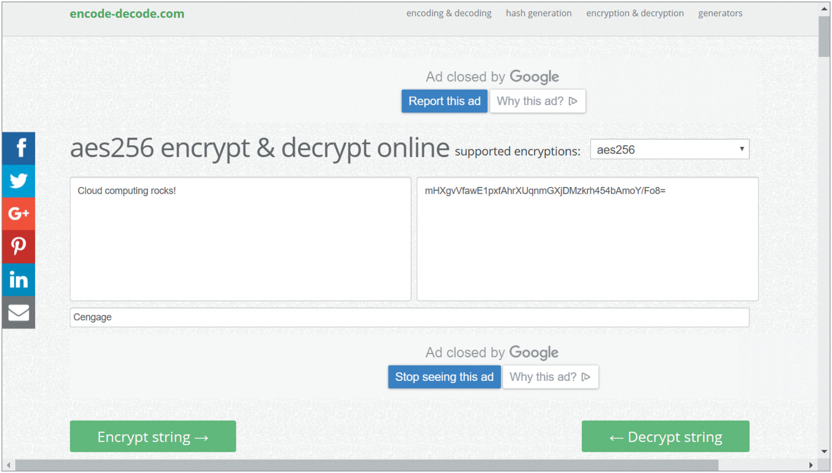
Data Security (3 of 13)
Figure 6-13 AES encryption is considered secure.
Notes:
Data that have not been encrypted are called plaintext and can be read without any special decoding. However, encrypted data look like gibberish.
Figure 6-13 shows the phrase “Cloud computing rocks!” encrypted using AES (Advanced Encryption Standard) encryption and the key “Cengage.” The encrypted output, mHXgvVfawE1pxfAhrXUqnmGXjDMzkrh454bAmoY/Fo8=, doesn’t reveal any pattern that would indicate the original text.

Slide 51
Data Security (4 of 13)
Securing data (cont’d)
Who can encrypt data stored in the cloud?
Company who owns the data, before data leave the company’s network
CSP where the data stored
Third-party encryption service
Encryption concerns specific to a cloud environment include:
Learning about CSP encryption capabilities, policies, and techniques
Determining where encryption keys are stored
Considering costs involved with each available option
Notes:
Encryption concerns specific to a cloud environment include the following:
Learning about the encryption capabilities, policies, and techniques of the CSP.
Determining where the encryption keys are stored. Keys stored with the data might be more convenient—both for you and for any hackers. Therefore, in most cases, keys should be stored in a location that is isolated from the data those keys encrypt.
Considering the costs involved with each of the options available to you. Performing encryption in-house before sending data to the cloud might be more cost-effective as well as more secure if this works in your situation. There are trade-offs in functionality, however, such as not being able to search or edit files stored in the cloud without first downloading and decrypting them.

Slide 52
Data Security (5 of 13)
Securing data (cont’d)
CIA (confidentiality, integrity, and availability) security model
Describes primary ways encryption protects data
Confidentiality ensures that data can only be viewed by the intended recipient or at the intended destination
Integrity ensures that data were not modified after the sender transmitted them and before the receiver picked them up
Availability ensures that data are available to and accessible by the intended recipient when needed
Notes:
To protect data at rest, in use, and in motion, encryption methods are primarily evaluated by three benchmarks, and together, these principles form the standard security model called the CIA (confidentiality, integrity, and availability) triad:
Confidentiality: Data can only be viewed by their intended recipient or at their intended destination.
Integrity: Data are not modified in the time after the sender transmits them and before the receiver picks them up.
Availability: Data are accessible to the intended recipient when needed, meaning the sender is accountable for successful delivery of the data.

Slide 53
Data Security (6 of 13)
Encryption techniques
Cipher
Mathematical code used by encryption protocols
Scrambles data so it can only be read by reversing the cipher
Reversing the cipher: known as deciphering or decrypting the data
Common protocols used to support encryption
DES (Data Encryption Standard): retired
3DES (pronounced Triple DES): newer than DES and retired
RC5 (Rivest Cipher 5) or RC6: more current ciphers
SHA-2 (Secure Hash Algorithm, version 2) or SHA-3: hashing functions
AES (Advanced Encryption Standard): popular encryption standard
Notes:
Encryption protocols use a mathematical code, called a cipher, to scramble data into a format that can be read only by reversing the cipher—that is, by deciphering, or decrypting, the data.
Cipher refers to a mathematical code used to scramble data into a format that can only be read by reversing the cipher.

Slide 54
Data Security (7 of 13)
Encryption techniques (cont’d)
Most secure forms of encryption encode the original data’s bits using a long and complex key
Key refers to a series of characters combined with a block of data during data’s encryption process
Key used to scramble data and generate a unique and consistently sized data block called ciphertext
Key created and used according to a specific set of rules or algorithms
Common use of keys
WPA2-Personal Wi-Fi security relies on a pre-shared key (PSK)
Complex and randomized keys generated by techniques such as ECC (elliptic curve cryptography)
Notes:
Most secure forms of encryption encode the original data’s bits using a long and complex key—sometimes several times in different sequences—to scramble the data and, from the data, generate a unique and consistently sized data block called ciphertext. The key is created and used according to a specific set of rules, or algorithms.
A key refers to a series of characters combined with a block of data during the data’s encryption process.
More complex and randomized keys can be generated by techniques such as ECC (elliptic curve cryptography), which uses elliptic curves, such as what you might have seen in algebra, to generate a public and private key pair that are mathematically related in a way that is impossible to predict.

Slide 55
Data Security (8 of 13)
Encryption techniques (cont’d)
Private key encryption
Data encrypted using single key only the sender and receiver know
Same key used during both the encryption and decryption processes
Known as symmetric key encryption
Potential problem: sharing key with the recipient without compromise
Public key encryption
Provides integrity or confidentiality
Known as asymmetric key encryption
Uses a key pair: combination of a public key and a private key

Slide 56
Data Security (9 of 13)
Encryption techniques (cont’d)
Public key encryption with data integrity
Data encrypted with a private key known only to the user
Data decrypted with mathematically related public key available to the public through a third-party source
Sender’s public key will work only if data have not been tampered with
Public key encryption with confidentiality
Data encrypted with the public key
Data decrypted with the matching private key
Only the intended recipient can decrypt data

Slide 57
Data Security (10 of 13)
Encryption techniques (cont’d)
On-prem KMS (key management system)
Key Orchestration KMS by Fornetix
qCrypt™ by Quintessence Labs
Cloud provider KMS (key management services)
AWS’s KMS
Azure’s Key Vault
GCP’s Cloud KMS

Slide 58
Data Security (11 of 13)
SSL and TLS
Public key encryption protocols
Commonly used to encrypt communications across the Internet
SSL (Secure Sockets Layer)
Method of encrypting TCP/IP transmissions
TLS (Transport Layer Security)
SSL version standardized by IETF (Internet Engineering Task Force)
Very similar to the most recent version of SSL
Uses slightly different encryption algorithms from SSL
Notes:
SSL (Secure Sockets Layer) and TLS (Transport Layer Security) are two public key encryption protocols commonly used to encrypt communications across the Internet.
SSL (Secure Sockets Layer) refers to a method of encrypting TCP/IP transmissions—including web pages and data entered into web forms—en route between the client and server using public key encryption technology.
TLS (Transport Layer Security) refers to a version of SSL standardized by the IETF (Internet Engineering Task Force). TLS uses slightly different encryption algorithms from SSL but otherwise is very similar to the most recent version of SSL.

Slide 59
Data Security (12 of 13)
SSL and TLS (cont’d)
All browsers today support SSL/TLS
Differentiates HTTP and HTTPS or FTP and FTPS
SFTP (Secure FTP) relies on SSH, not SSL/TLS
TLS operates in the Transport layer
Uses slightly different encryption algorithms from SSL
Essentially an updated version of SSL
SSL operates in the Application layer
Originally developed by Netscape
SSL has been deprecated and should be disabled
Notes:
All browsers today support SSL/TLS to secure transmissions of website traffic, which is what makes the difference between HTTP (Hypertext Transfer Protocol) traffic and the more secure HTTPS (HTTP Secure) traffic, or the difference between FTP (File Transfer Protocol) and FTPS (FTP Secure or FTP over SSL). Note, however, that SFTP (Secure FTP) relies on SSH, not SSL/TLS.
SSL was originally developed by Netscape and operates in the Application layer. Since that time, the IETF (Internet Engineering Task Force), which is an organization of volunteers who help develop Internet standards, has standardized the similar TLS protocol. TLS operates in the Transport layer and uses slightly different encryption algorithms from SSL but otherwise is essentially the updated version of SSL. SSL has now been deprecated and should be disabled.

Slide 60
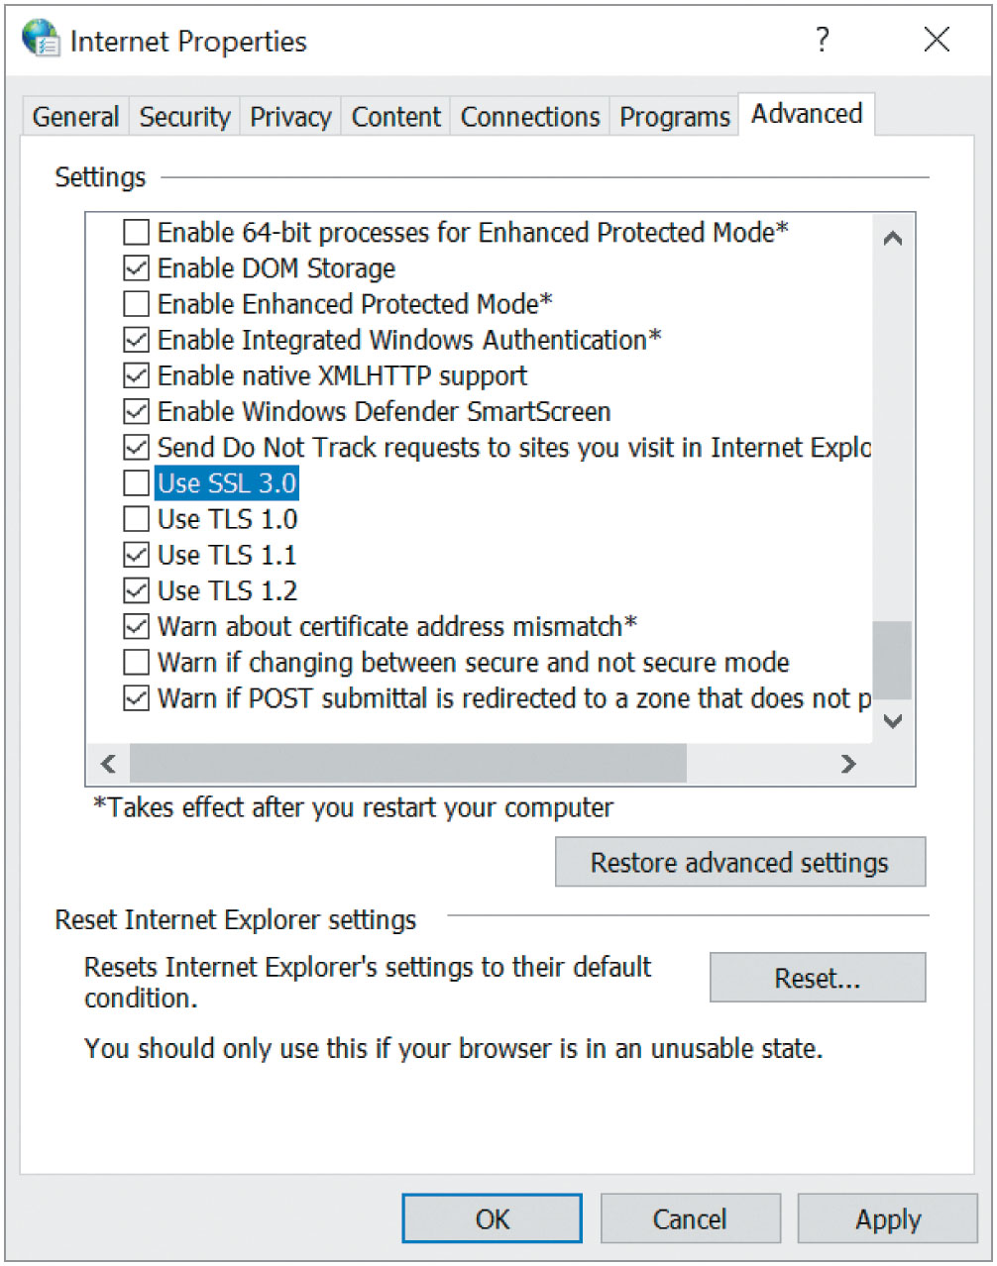
Data Security (13 of 13)
Figure 6-14 TLS is a more secure option for encryption.
Notes:
SSL has now been deprecated and should be disabled whenever possible, as shown in Figure 6-14, leaving the more secure TLS to provide protection. In reality, you’ll often see them both enabled for backward compatibility.

Slide 61
Troubleshooting Cloud Security (1 of 2)
Common cloud security issues
Unencrypted data and unencrypted communications
Ensure sensitive data (at rest, in motion, in use) are securely encrypted
Use reliable encryption protocols
Weak or obsolete security technologies
IT professionals must keep up-to-date on latest security developments
Incorrect hardening settings
Have pretty good default system hardening settings at instance level
Watch for console warnings indicating need to tighten security settings
Close up blind spots or backdoors
Notes:
Security techniques rely on proper configurations and consistent maintenance. A huge majority of security failures result from user or administrative error.
إعدادات تصلب غير صحيحة
Unencrypted data and unencrypted communications. Breaches happen. When they do, encrypted data can mean the difference between a learning opportunity and a career-breaking crisis. Make sure that all sensitive data, whether at rest, in motion, or in use, are securely encrypted using reliable encryption protocols.
Weak or obsolete security technologies. As an IT professional, keep your own knowledge up-to-date on the latest developments in security techniques relative to your work.
Incorrect hardening settings. Most default system hardening settings at the instance level are pretty good. For example, Windows Server on a VM benefits from built-in defenses that typically don’t need adjusting from their default settings. However, hardening settings within the cloud platform can be problematic. Oftentimes, default settings allow for maximized access while you’re setting up your resources. Watch for warnings in your console indicating you need to tighten security settings, and be wary of areas where cloud admins tend to leave blind spots or backdoors so you can close these up.

Slide 62
Troubleshooting Cloud Security (2 of 2)
Common cloud security issues (cont’d)
Security device failure
Utilize failovers and redundant systems to minimize impact
Encryption issues
Use good key management: rotating, protecting, and isolating keys
Store current backups securely in another location
Insufficient security controls and processes
Consider network design carefully and employ logging where needed
Unauthorized physical access
Be aware and vigilant of risks involving an attacker’s physical access to the organization’s trusted endpoint devices
Notes:
Security device failure. Security devices do fail sometimes. Failovers and redundant systems can minimize the impact of these events.
Encryption issues. Good key management can make encrypting and decrypting data more convenient. However, problems arise if the keys are too convenient, such as being stored in the same location as the data, or when storing keys temporarily in memory while they’re being used. Keys should be kept in a protected, isolated environment with current backups stored securely in yet another location, and keys should be regularly rotated. (Don’t forget to update backups at the same time.)
Insufficient security controls and processes. Poorly designed networks can leave gaps and blind spots where intruders can enter, or data might be exposed to the open Internet. When a security event occurs, insufficient logging can prevent you from learning what went wrong and how to fix the problem. Consider network design carefully, and employ logging where needed.
Unauthorized physical access. Although the cloud consumer is not responsible for managing physical access to hardware supporting a public cloud, you and the other employees at your organization still need to be aware and vigilant of risks involving an attacker’s physical access to the organization’s trusted endpoint devices, such as workstations and mobile devices, and an attacker’s ability to use social engineering to collect sensitive information that could be used to illegally access and manipulate cloud resources.

